Slide 1


Lyme Disease: Case Trends, Climate, and Risk Across the U.S.
Daniel zapata
Nashville software school
Notes:
Hi, thank you for joining me! Today, we’re going to be discussing Lyme Disease and exploring case trends, impact of climate change, and risk across the United States.

Slide 2
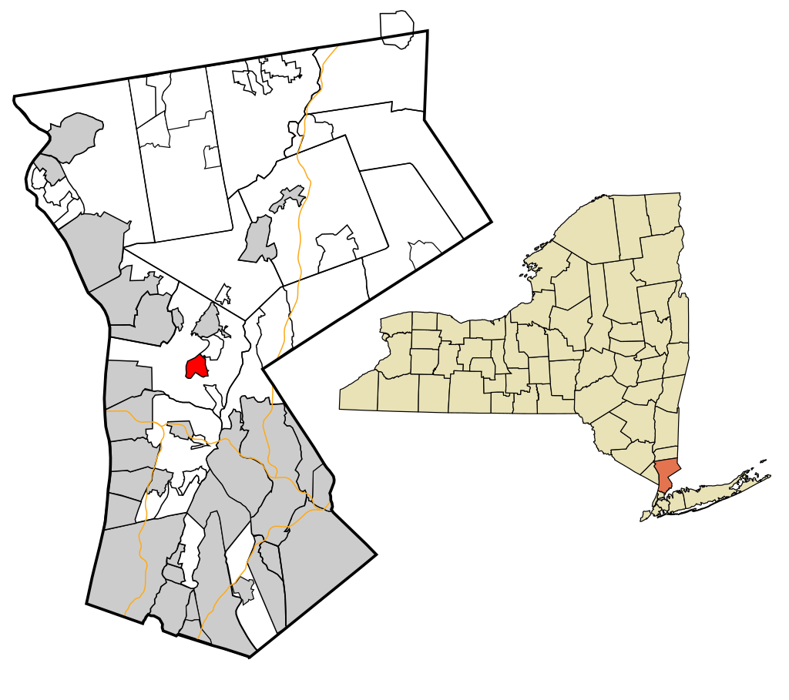
Motivation
01. Grew up in New York
02. Spent time outdoors
03. Road trips across the Northeast
04. Contracted Lyme disease twice
05. Explore risk in Nashville, TN
Notes:
I grew up in New York just 30 miles north of New York City in the suburbs. As a kid, I contracted Lyme disease twice, which we caught early, so I was able to get treated and recovered fully with no lasting effects. Then I moved down to Nashville in 2012 and remember being told there really wasn’t any Lyme down here. This project allowed me to actually dig into the data and investigate whether that claim was true or not.

Slide 3




Questions to Explore
How has Lyme disease changed over the past several decades in the United States?
Which states are most affected by Lyme disease and has that changed over time?
Which states have experienced the most significant increase in cases?
Is there a relationship between winter temperatures and case counts?
Does adjusting for population change which states are considered most at risk?
What is the risk of Lyme disease in Tennessee and specifically, Davidson County?
Notes:
Some of the questions I was interested in answering pertained to how Lyme disease has evolved over time, what areas of the country are most affected, what effect (if any) has climate change had on cases, and finally, what my risk looks like living here in Nashville, TN.

Slide 4
Data Sources
Centers for Disease Control and Prevention (CDC)
National Centers for Environmental Information
United States Census Bureau
Case counts by month and year
Case counts by state
Case counts by county
US average monthly temperatures
Regional average temperatures
State average temperatures
US population by year
State populations by year
Tennessee County populations by year
Notes:
To answer these questions I used three main data sources:
The CDC for reported cases
The National Centers for Environmental Information for temperature data
And the US Census Bureau for population data
A quick note regarding the Lyme disease case counts. Although there is federal guidance, policies and surveillance practices vary by state, which results in limitations in the data. The analysis presented here uses the officially reported surveillance data, which is just one way Lyme cases are tracked. Other methods suggest the actual number of cases may be significantly higher.

Slide 5
Lyme Disease
Bacterial infection spread through the bite of blacklegged (Ixodes) ticks
Typical symptoms include fever, headache, fatigue, and a characteristic skin rash
Treated with antibiotics
Untreated can lead to more severe symptoms
Notes:
So first, I’d like to start off with a quick introduction on what Lyme disease is.
It is a bacterial infection that is spread to people through the bite of blacklegged ticks also known as deer ticks. Symptoms can include fever, headache, fatigue, and a characteristic skin rash. Lyme disease is highly treatable with antibiotics when caught early, and even most patients with later-stage infections respond well to treatment. However, untreated infection could spread to the joints, the heart, and the nervous system.
.

Slide 6
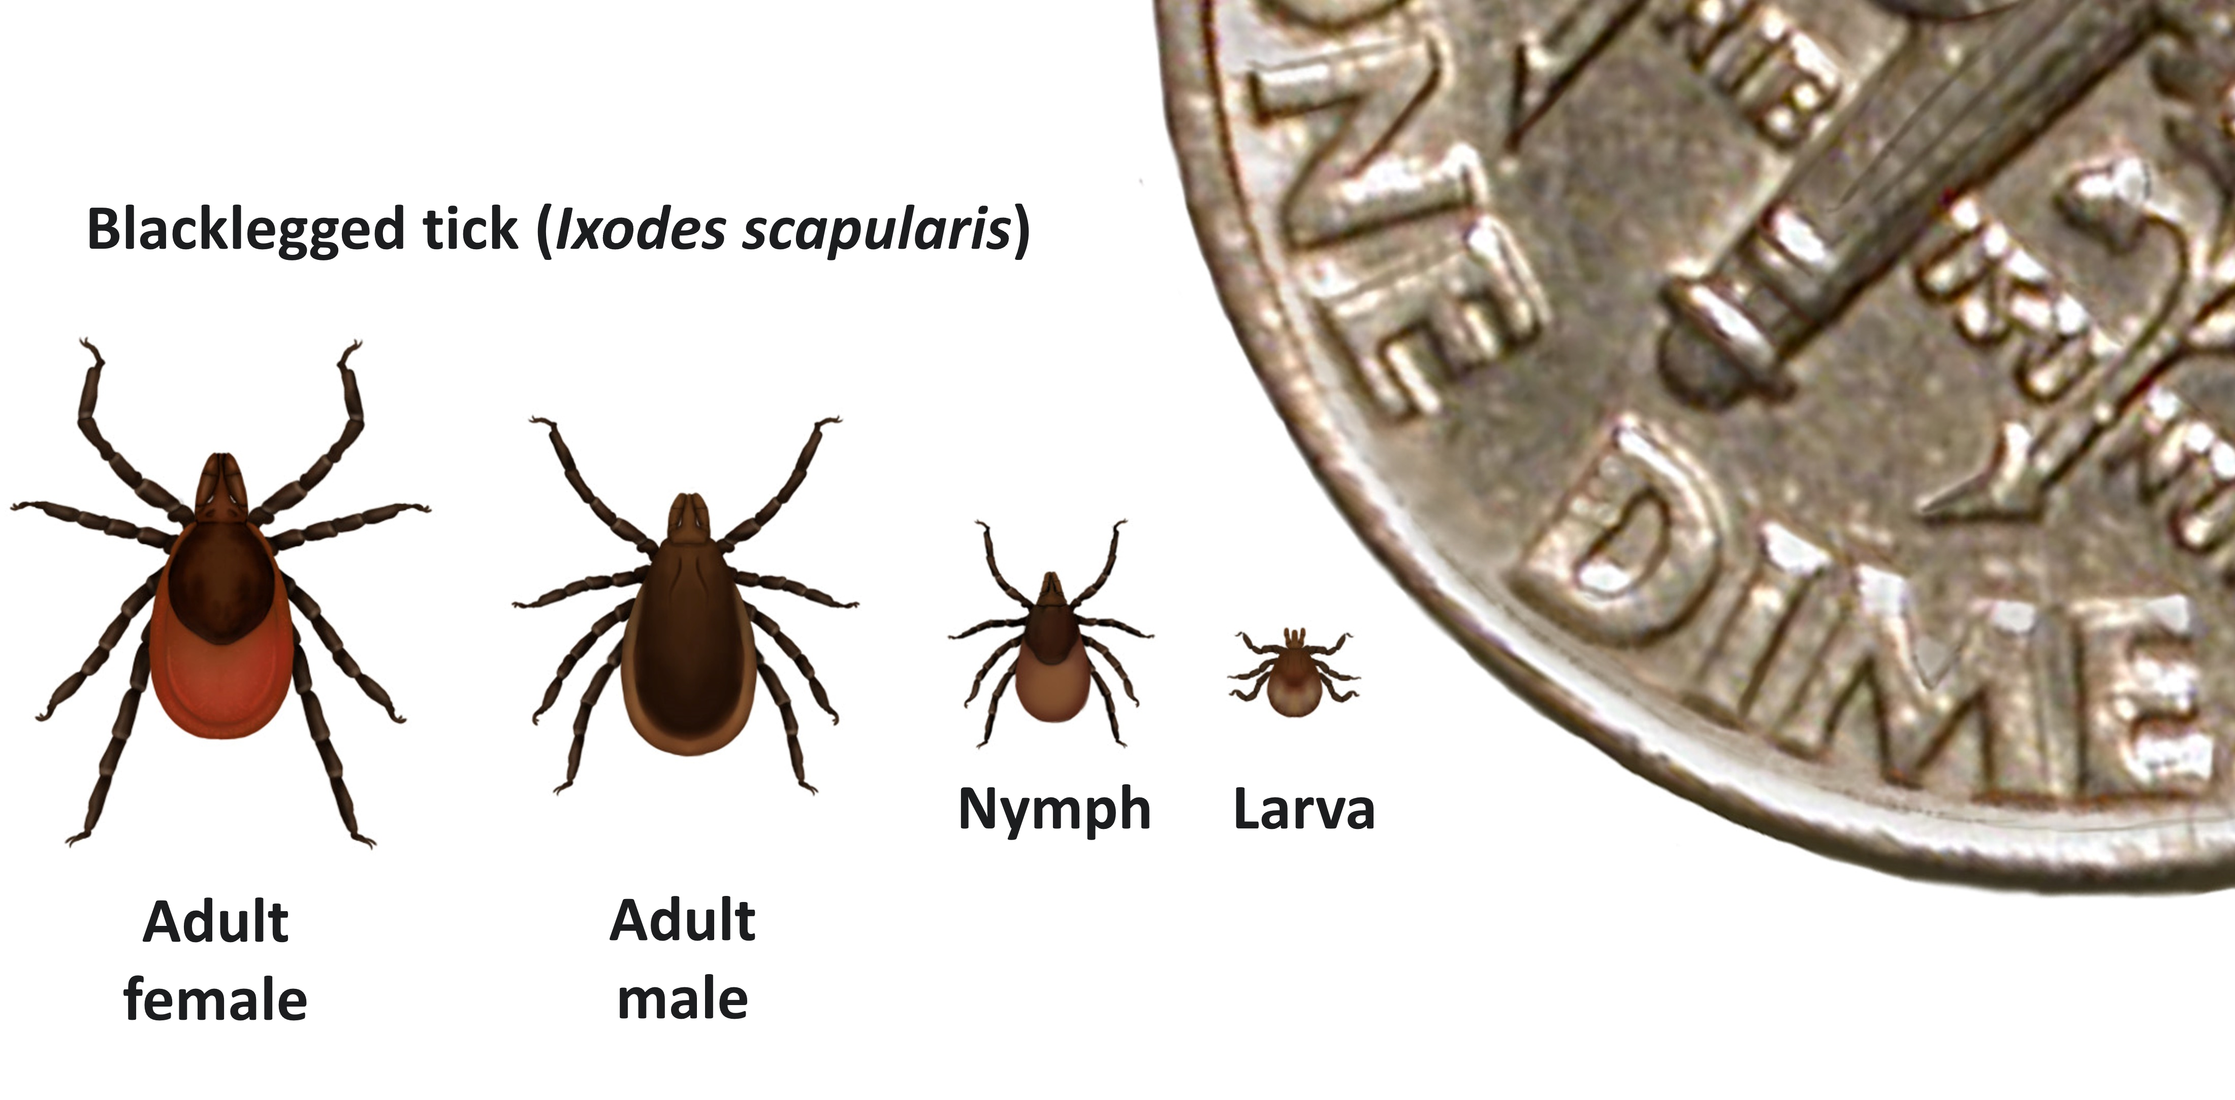
Blacklegged Ticks
Found most commonly in forested areas
2 to 3 year lifespan
4 life stages
Notes:
Next, it’s helpful to understand a little bit about the ticks, which are responsible for transmitting the bacteria that causes Lyme disease. Blacklegged ticks are most commonly found in forested areas of the Northeast, north-central, and mid-Atlantic states, with smaller populations along the Pacific Coast. They typically have a 2 to 3 year life cycle with four stages: egg, larva, nymph, and adult.

Slide 7
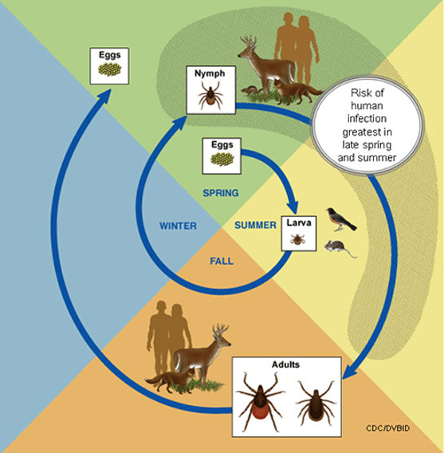
Tick Life Cycle
Require a blood meal
Smaller animals infect the ticks
Attach for at least 24 hours
Notes:
For a tick to transition between life stages they require a blood meal from a host. Adult females also require a blood meal in order to produce eggs, It’s during these blood meals the ticks can become infected with the Lyme disease bacteria from animals such as mice. They then can pass it on to their next host when feeding again. Ticks are most active during warmer months and become dormant in freezing temperatures.

Slide 8
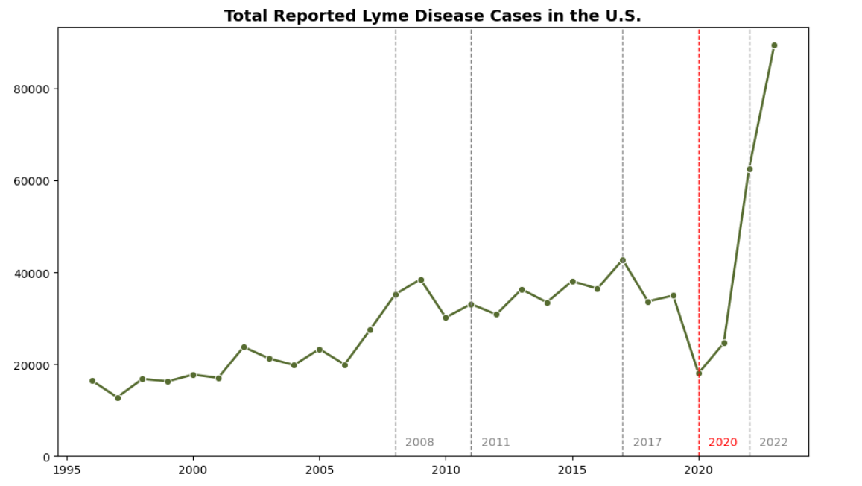
US Case Counts
Notes:
Now we’ll begin with looking at case trends across the country.
Here we see the total number of cases across the US from 1996 to 2023. The dashed lines are years that the case definitions for Lyme disease were modified. The red dashed line in 2020 represents COVID. Around this time we see a dip in reported cases, which can be explained by underreporting due to strained resources. We see in 2022 there appears to be a significant rise in cases. This could be due to the reporting behaviors normalizing after a couple of years of COVID as well as a rule change that made it easier for some states to report cases of Lyme. 2023 saw about 89,000 cases reported.

Slide 9
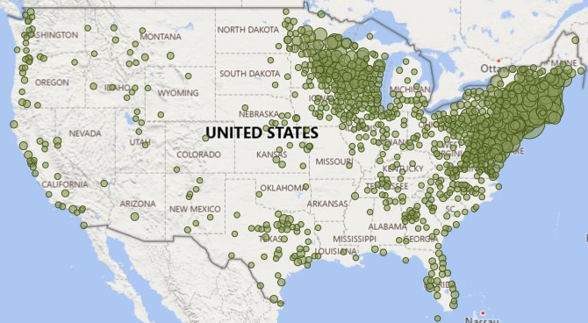
2008
Notes:
We’re going to focus on cases between 2008 and 2023 where we have the most complete data on a state and county level. One thing I want to mention here is that cases are reported based on county of residence, not necessarily county of exposure.
This is a map displaying case distribution by county in 2008. Although we see reported cases all across the country, there are some obvious hot zones. Take note of this area here where there’s kind of a break between those zones.

Slide 10
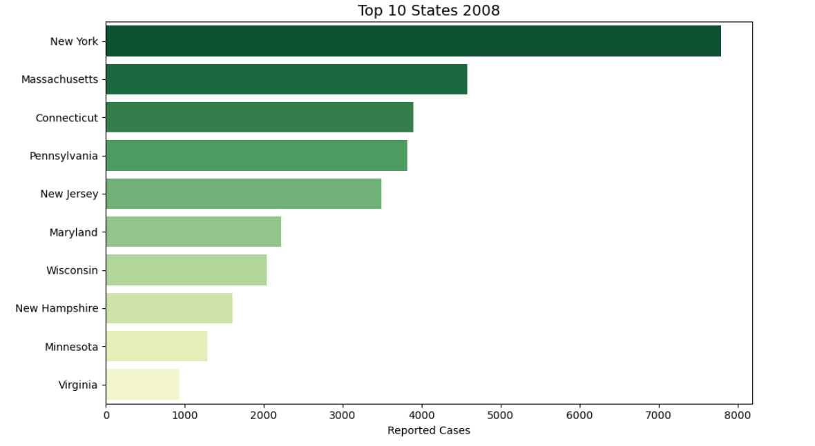
States with the Highest Counts in 2008
Notes:
As expected, based on where blacklegged ticks are most found- states in the northeast like New York and Massachusetts and states in the north-central region like Wisconsin and Minnesota, had the highest counts of Lyme disease in 2008

Slide 11
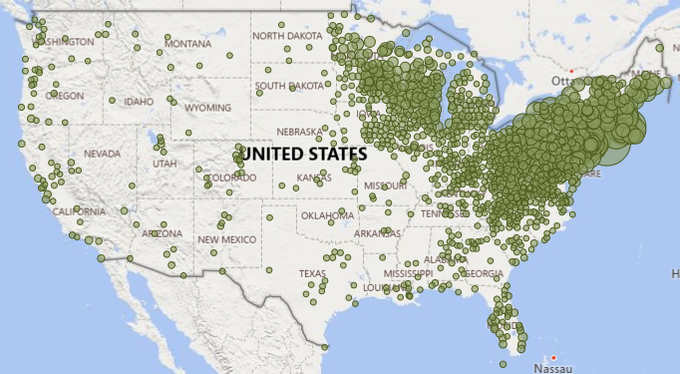
2023
Notes:
Moving forward to 2023- we still see those same hot zones, but now we’re also seeing an increase in cases in states like Ohio, West Virginia, and Michigan. Case counts are not only growing, but expanding geographically.

Slide 12
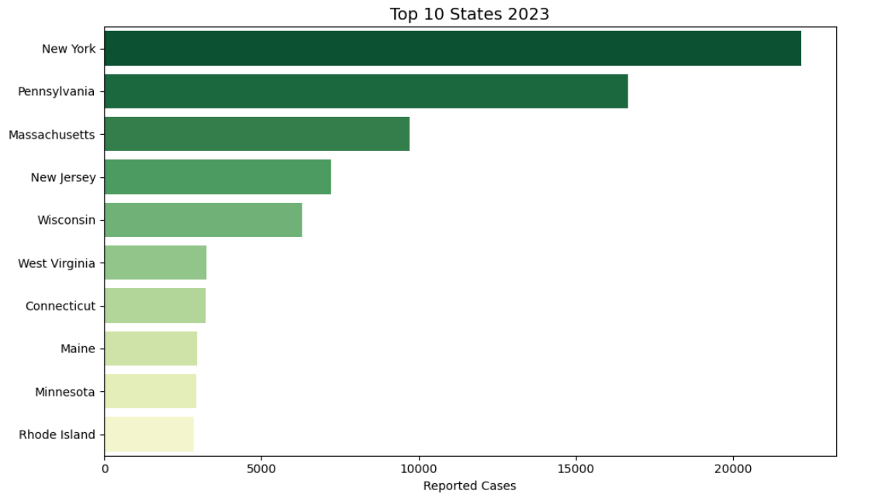
States with the Highest Counts in 2023
Notes:
Once again, when we look at the highest total case counts we’re seeing the same states and regions as in 2008. This makes sense since this is where these ticks have historically lived and have a foothold already.

Slide 13
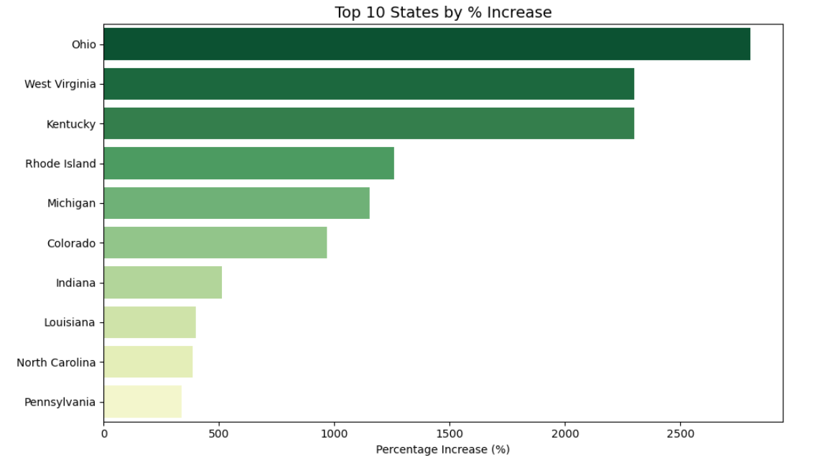
States with the Highest % Increase
Notes:
However, I was interested about which states saw the greatest percentage increase in cases. Here we see Ohio had the greatest increase in reported cases in that time frame growing from 45 in 2008 to a little over 1300 in 2023. West Virginia went from 135 to about 3200.

Slide 14
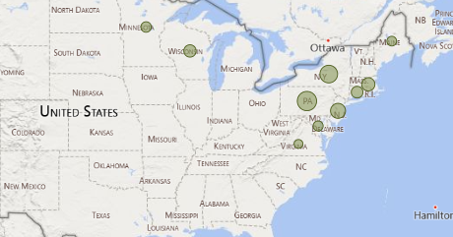
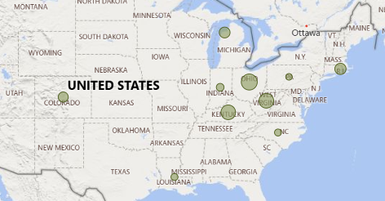
Top 10 States by
Total Cases
Top 10 States by
% Change
Notes:
When we shift our focus from pure case count to percentage change- we start to see that geographic expansion out of the northeast and north-central regions. This made me curious about what factors could be contributing to the rise in case counts in general, but also more specifically in some of these states experiencing such dramatic growth. That’s when I decided to concentrate on how temperature may be impacting Lyme disease.

Slide 15
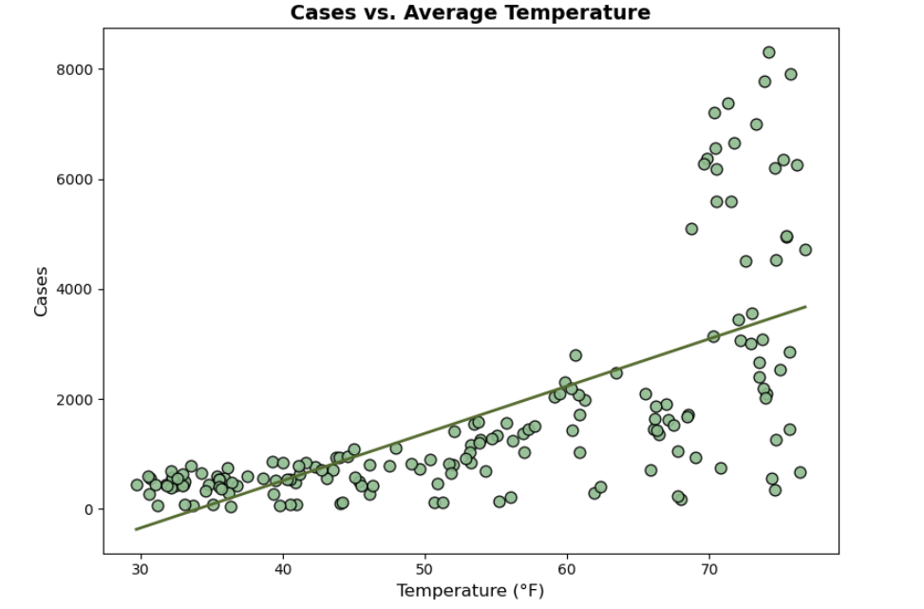
US Cases vs Average Temperature
Notes:
When we look at total cases of Lyme in the US compared to the average temperature of when those cases are being reported, we see very clearly a positive relationship. Around the freezing point, there are hardly any cases reported at all, but as the weather warms up, cases of Lyme go up. This aligns with tick behavior and that they are more active during the warmer temperatures- questing for hosts and potentially contracting and spreading the Lyme disease bacteria.

Slide 16
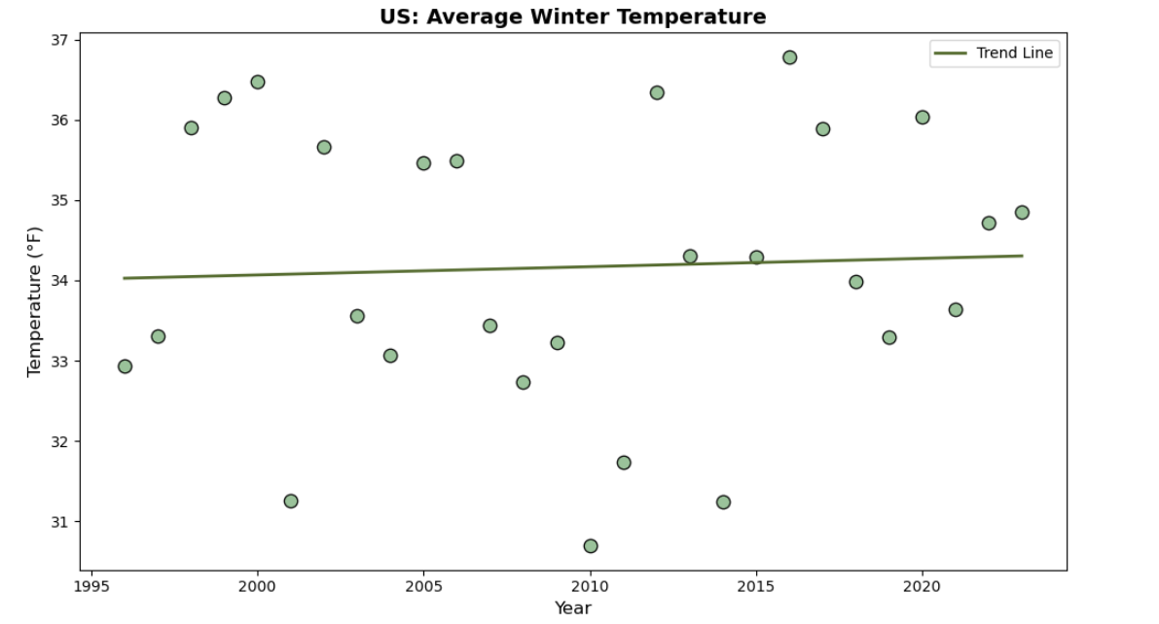
US Average Winter Temperature
Notes:
We know that temperatures are rising globally and from the last graph, we learned a majority of cases are reported when temperatures are higher. Although temperatures are rising, it’s incremental, so I wasn’t very interested in temperatures during the warmer months. I figured tick behavior and Lyme cases wouldn’t vary too much. As temperatures stay above freezing, ticks are less dormant and so I was interested in what kind of impact winter temperatures have on total cases reported for the year. I designated December, January, and February as “Winter” and found the average temperature across those three months for the US. Here we see a slight increase in average winter temperatures over time.

Slide 17
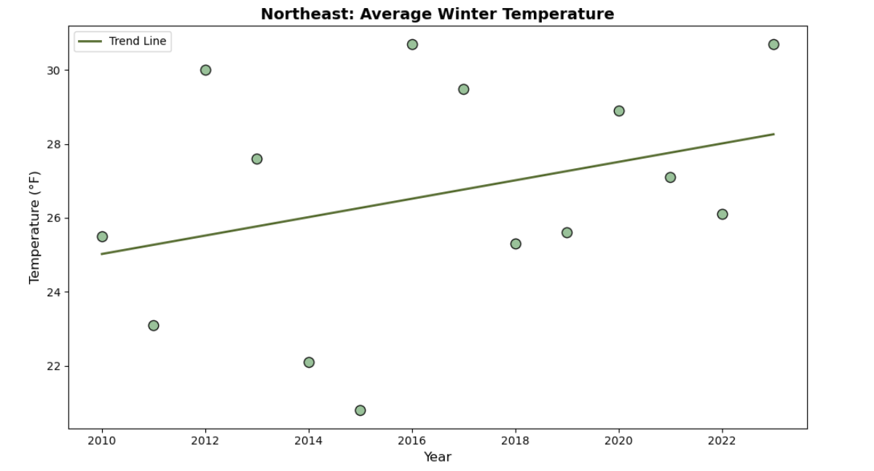
Northeast Average Winter Temperature
Notes:
I first wanted to focus on the Northeast- the region we know has the most Lyme disease. This graph shows that the average winter temperature is rising.

Slide 18
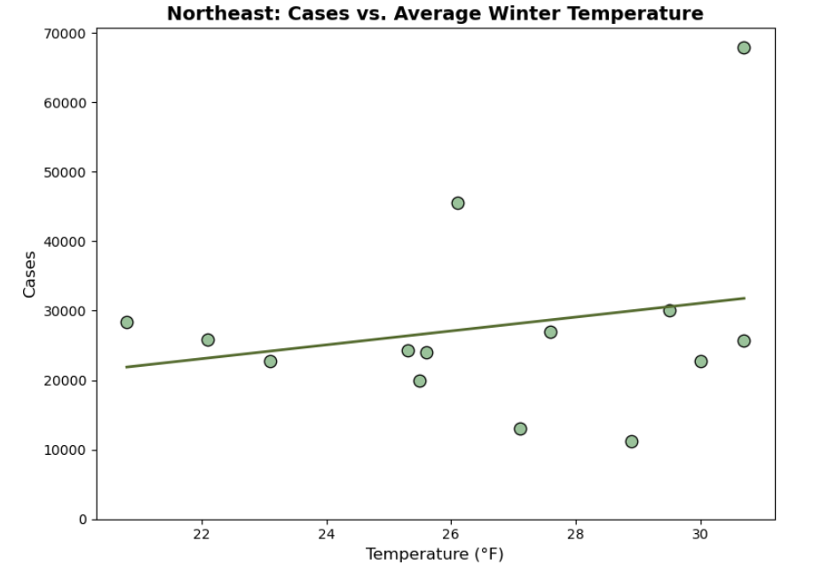
Northeast Cases vs. Average Winter Temperature
Notes:
When we look at total cases versus average winter temperature- we see a slight positive relationship, but nothing too strong and I think this is because if you notice on the graph, temperatures average below freezing. Which means the tick active season has pretty much remained constant.
I will note the data point in the top right corner is from 2023. We saw earlier that there was a sharp rise across the board in case counts that year- most likely due to the change in case definition. We will see a point like this on all of the graphs.

Slide 19
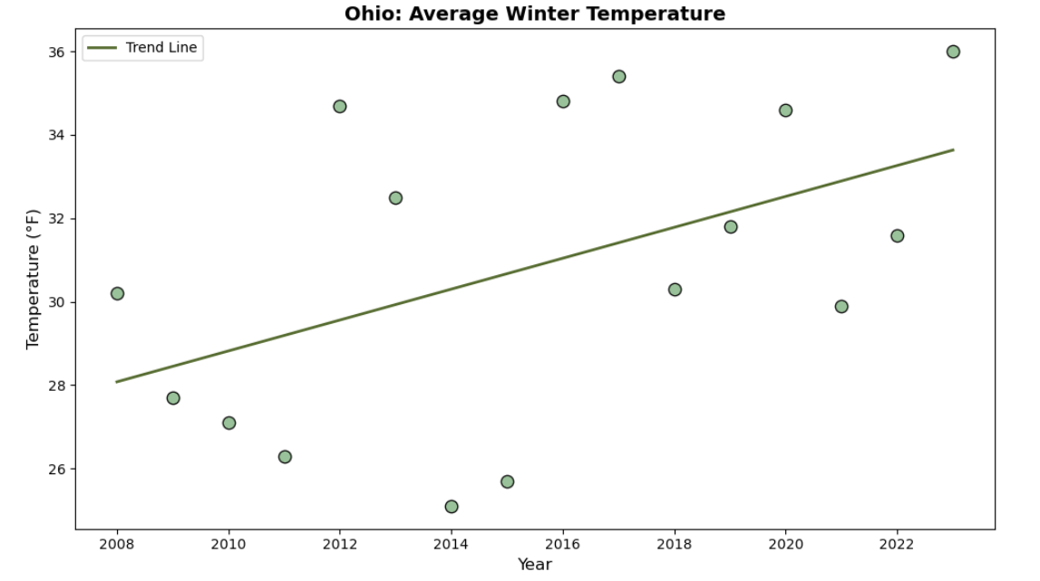
Ohio Average Winter Temperature
Notes:
I then wanted to look at a couple of those states that had the highest percentage change in cases. First we’ll look at Ohio.
Here is a graph showing the change in average winter temperature and we can clearly see temperatures have been rising. Earlier in this time frame Ohio’s average temperatures are below freezing. As time goes on, it starts hovering around freezing or above.

Slide 20
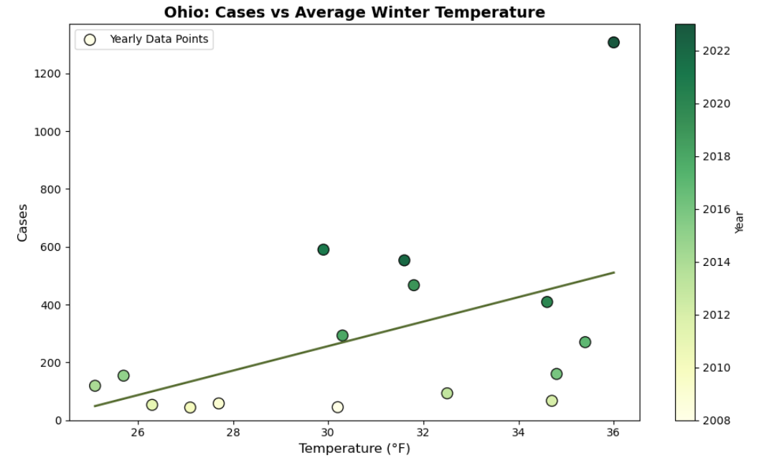
Ohio Cases vs. Average Winter Temperature
Notes:
This graph displays the relationship between average winter temperature and case count. We see a stronger relationship here than in the Northeast data- as temperature goes up, so does the total case count for the year- both of which have been on the rise over the past 15 years.

Slide 21
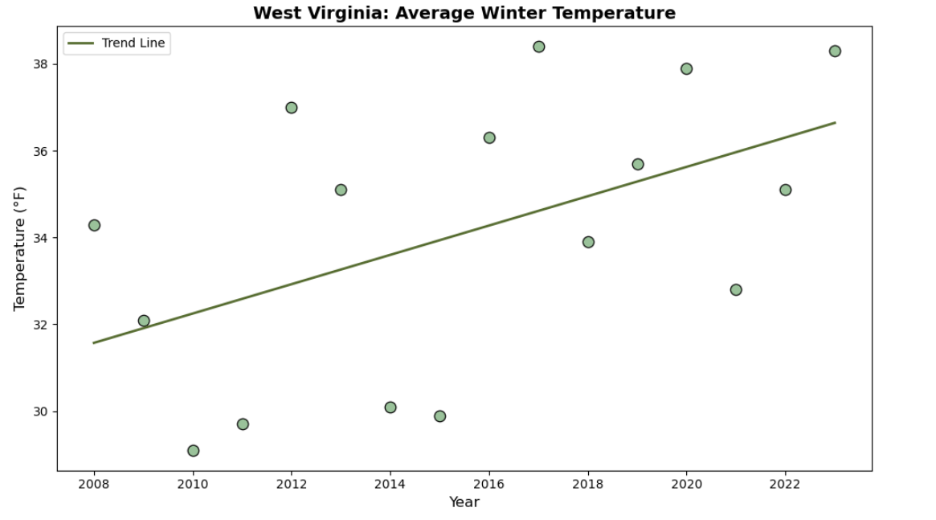
West Virginia Average Winter Temperature
Notes:
Next we’ll look at West Virginia. Once again, we are seeing a rise in average winter temperatures.

Slide 22
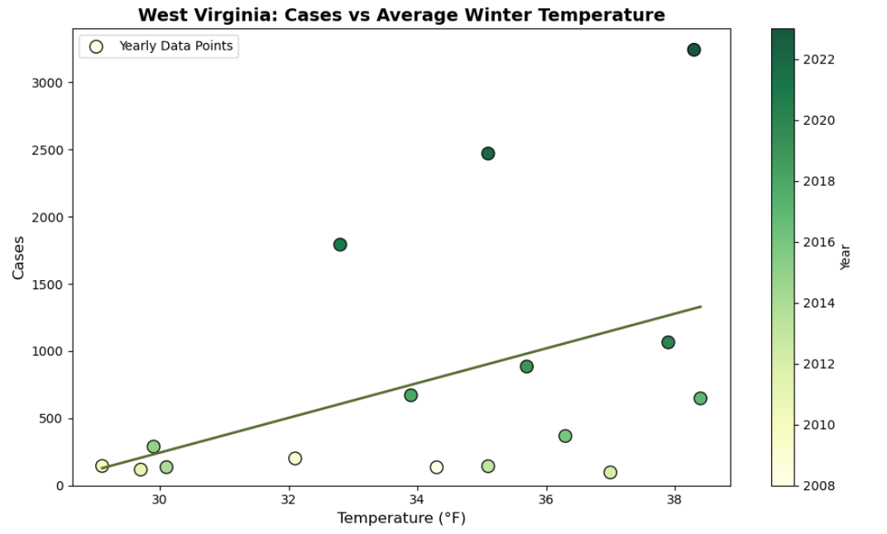
West Virginia Cases vs. Average Winter Temperature
Notes:
As with Ohio, we’re seeing a positive relationship between winter temperatures and total cases in West Virginia.
Any time temperatures go above freezing, ticks become active. As the winters get warmer the ticks active season grows along with their potential to spread disease. Areas that were once not as hospitable to the blacklegged ticks due to colder winters may begin to see more cases in the future. Especially in these border states outside of the high concentration regions that have winter temperatures that currently hover around freezing- as those averages begin to move up and stay above freezing, we may see cases start to rise, which I think we’re already starting to see here.

Slide 23
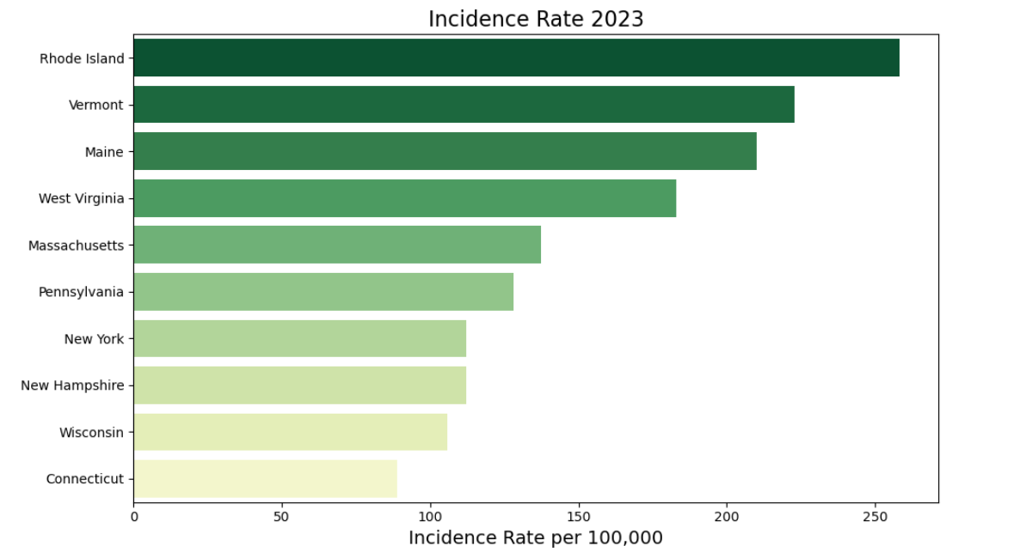
Incidence Rates 2023
Notes:
Now, up to this point, we’ve been looking at trends based on case counts. The number of cases has been growing and spreading and honestly, doesn’t look too promising. However, we need to take a step back and look at Lyme disease taking population size into account to get a real idea of risk levels.
When you factor in population size to calculate the Incidence Rate for 2023, we see that it’s not New York, the state with the highest case count, that is most at risk. It’s Rhode Island with about 258 cases per 100,000 people. New York’s Incidence rate is about 112. And in fact, 6 of the Top 10 states with the highest incidence rates are in New England- making it easily the most at risk region for contracting Lyme

Slide 24
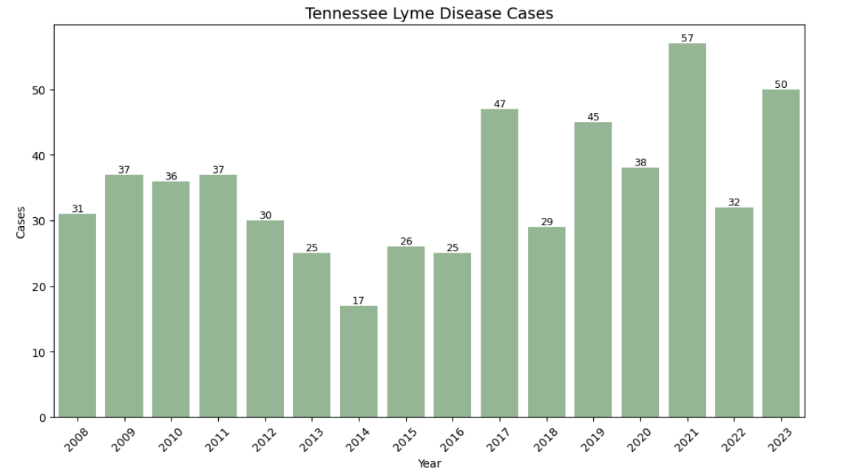
Tennessee Case Counts
Notes:
Fortunately, I live far away from there now, so I want to narrow our focus to Tennessee and evaluate our risk for Lyme in Davidson County. Here we see cases across the state have been fairly low since 2008. In 2023, there were only a total of 50 cases across the entire state.

Slide 25
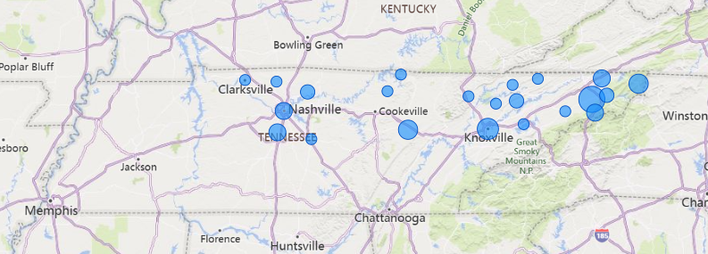
Tennessee Cases 2023
Notes:
Those 50 cases were widely distributed, but mostly in Middle and East TN.

Slide 26
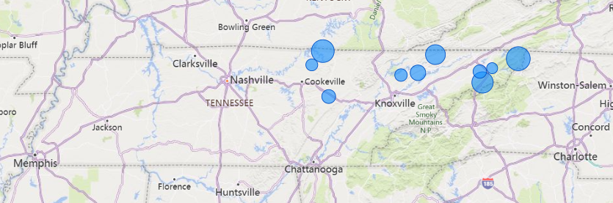
Tennessee County Incidence Rates 2023
Notes:
When we factor in population size, all of the counties with the highest incidence rates are concentrated in the northeastern portion of the state. Johnson County has the highest rate of about 22 cases per 100,000. However, it’s important to note that it only had 4 cases reported in 2023. We also notice that Davidson county has fallen off the map.

Slide 27
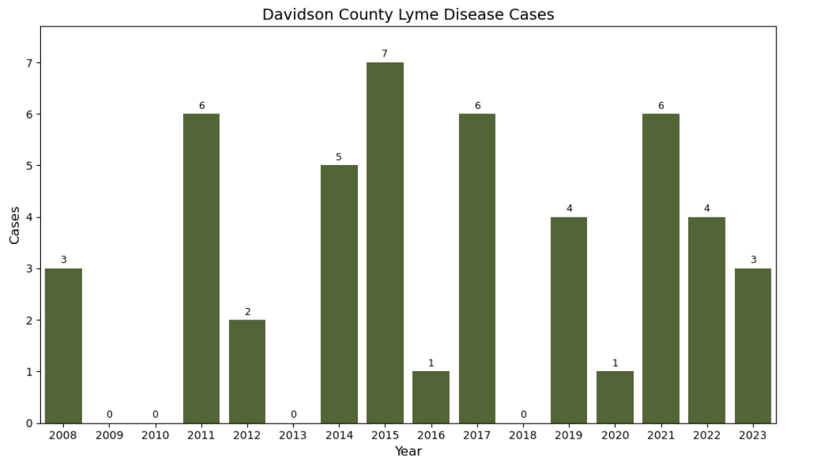
Davidson County Case Counts
Notes:
For a county with over 700,000 residents, there have been very few reported cases of Lyme in Davidson. Only 3 cases in 2023, which calculates to .42 cases per 100,000 people. That is very low- almost non existent. And looking at the maps from before- makes me think that those 3 cases could be people who live in Nashville, but who travelled elsewhere like maybe eastern TN for a vacation since cases are reported based on the county of residence.
This has been a huge relief! I feel fairly confident that I’m not going to contract Lyme disease here in town at the moment. However, as we saw Lyme has been spreading and our chances of contracting it may raise over time.

Slide 28
Opportunities for Further Analysis
Climate factors
Deer tick distribution
Behaviors and migration of host animals
Reporting
Deforestation
Urban development
Human behavior
Notes:
I have learned that Lyme disease is way more complicated than I imagined. There are many variables when it comes to exploring Lyme disease and its effect on humans. Climate change is just one piece of the puzzle as we’ve seen with rising temperatures we could start seeing a rise in Lyme. We saw some evidence of that in border states, but what will it look like if winter temperatures in the Northeast start averaging above freezing?
Other contributing factors like host animal behavior, migration, urban development, deforestation, the reporting practices themselves. The list goes on- all elements that need to be considered when studying the evolution of Lyme disease and the risk it poses to people.

Slide 29
Check for ticks!
Be aware of where ticks live
Wear long sleeves and long pants
Wear insect repellent
Check yourself after being outside
Notes:
I just want to thank you for your time and hope you have enjoyed learning a little bit more about Lyme disease and please don’t forget to check yourself for ticks!

